Slide 1
Predictive Analytics for Bank Marketing Campaigns: A Study on Term Deposit Subscriptions
Presentation Link: https://youtu.be/TUuO83_R4tA
Saran Raj Srinivasan School of Computing National College of Ireland Dublin, Ireland x22149066@student.ncirl.ie
Lakshmiraj Natarajan School of Computing National College of Ireland Dublin, Ireland x22173391@student.ncirl.ie

Slide 2
INTRODUCTION
Domain Focus: Financial growth in banking depends on acquiring new customers for products like fixed deposits, term deposits.
Project Overview: Perform predictive analysis using Logistic Regression, Random Forest, Gradient Boosting to predict customer subscriptions to Term deposits.
Data Source: Banking Marketing dataset available on Kaggle.
Key Objectives:
Analyze the dataset for insights.
Assess suitable techniques for predictive modeling.
Implement and interpret proposed models.
Quantitative and qualitative results analysis for banking business value.

Slide 3
HYPOTHESIS SPECIFICATION
Effects of Contact duration on prediction
Null Hypothesis H0: The last contact duration feature does not affect the prediction of customer subscription towards the term subscription.
Alternate Hypothesis H1: Customers with frequent contact are like to subscribe toward the term deposit higher.
Effects of Balance on prediction
Null Hypothesis H0: The balance feature does not affect the prediction of customer subscription towards the term subscription.
Alternate Hypothesis H1: Customers with higher balances are like to subscribe toward the term deposit.
Effects of Loans on prediction
Null Hypothesis H0: The loan feature does not affect the prediction of customer subscription towards the term subscription.
Alternate Hypothesis H1: customers with loans influence more towards in subscription towards the term deposit.
Effects of Age on prediction:
Null Hypothesis H0: The balance feature does not affect the prediction of customer subscription towards the term subscription.
Alternate Hypothesis H1: Customers with higher balances are like to subscribe toward the term deposit.

Slide 4
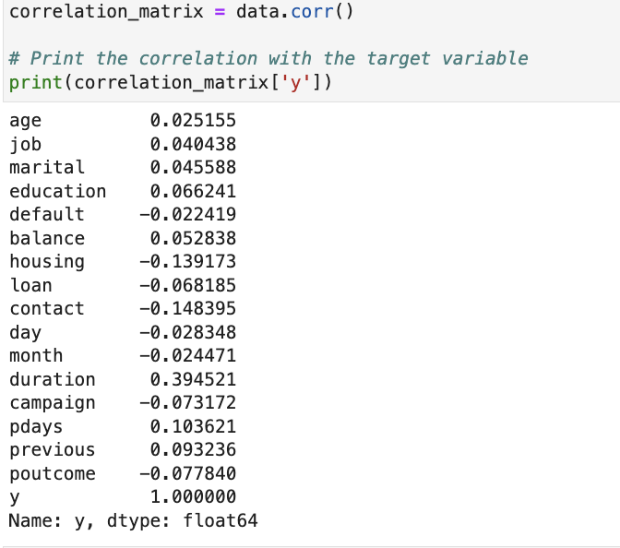
Assessment on choosen Techniques
Logistic Regression
Type: Supervised classification.
Assumptions: Nonlinear relationship between feature and target; no multicollinearity.
Advantages: Less computational; effective interpretation; probability estimation for impact analysis.
Suitable for: Non-technical stakeholders.
Assessment for Suitability
Correlation Analysis: No strong correlations between features (refer to image).
Interpretation: Nonlinear relationship indicates the influence of each feature on the term deposit subscription.

Slide 5
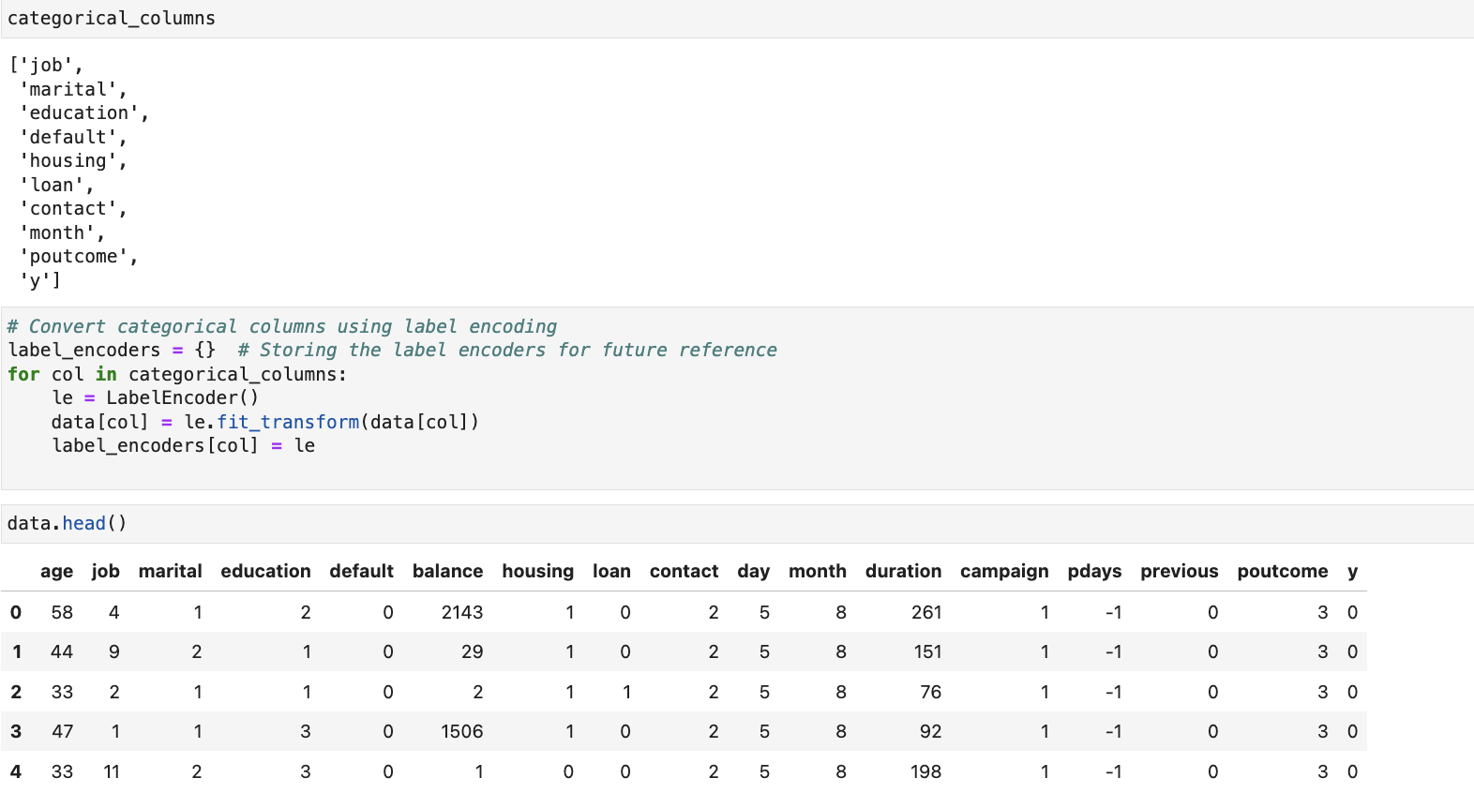
Assessment on choosen Techniques
Random Forest
Type: Ensemble learning, classification.
Assumptions: Handles nonlinear relationships, can manage high dimensionality.
Characteristics: Robust to outliers, handles categorical variables, offers feature importance.
Challenges: More computationally intensive.
Assessment for Suitability
Categorical Variables: Special handling of categorical variables by lable encoder refer with Fig.
Feature Importance: Provides insights into which features are most influential.
Applicability: Suitable for complex relationships and data with multiple features.

Slide 6
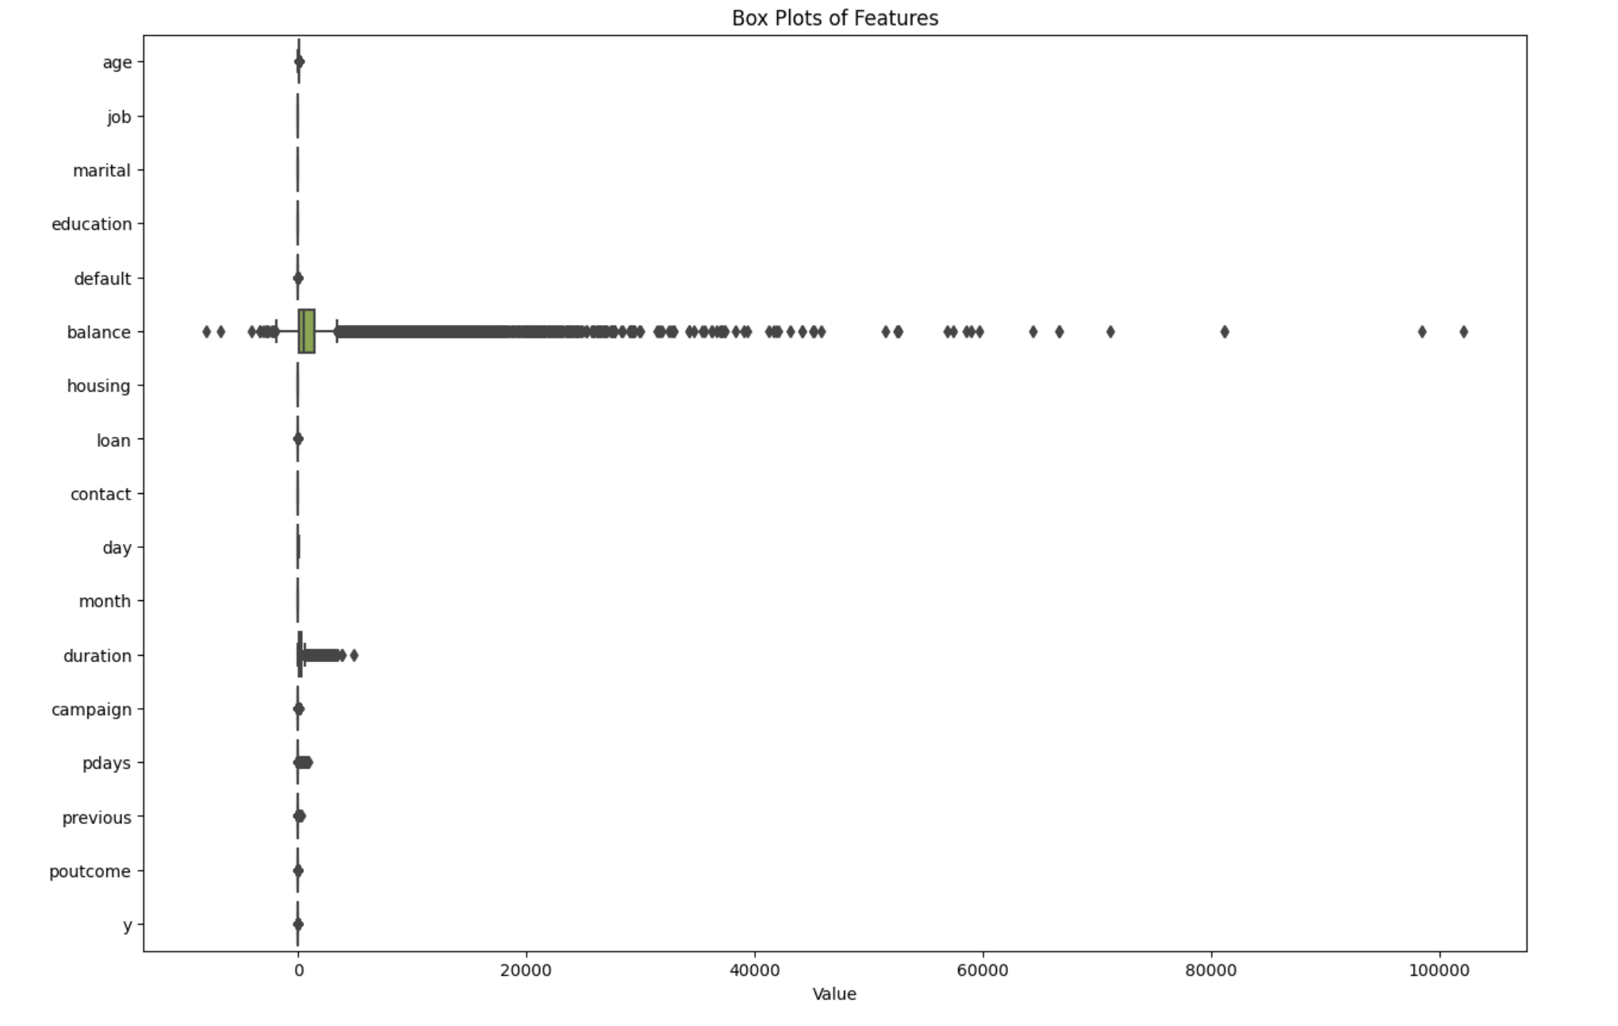
Assessment on choosen Techniques
Gradient Boosting
Type: Ensemble learning, iterative boosting.
Assumptions: Handles both linear and nonlinear relationships, combines decisions from multiple trees.
Characteristics: robust to outliers, potentially better accuracy.
Challenges: Increased computational time, may require balancing between accuracy and time constraints.
Assessment for Suitability
Flexibility: Capable of modeling linear and nonlinear relationships.
Outliers: Offers robustness by accommodating outliers.
Accuracy vs Time: Provides higher accuracy but may be time-consuming, choice depends on business model needs.

Slide 7
Data Preprocessing
Dataset Overview
Source: Banking Marketing dataset from Kaggle.
Features: Age, job, marital status, education, balance, housing, loan, etc.
Target: Customer subscription to term deposit (categorical).
Shape: 45211 rows and 17 columns.

Slide 8
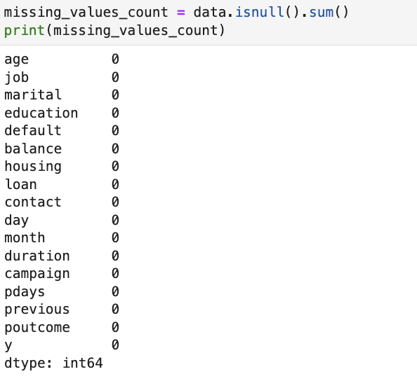
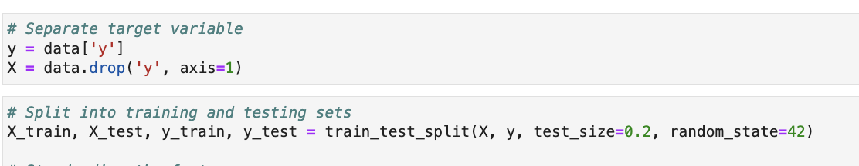
Data Preprocessing
Shape: 45211 rows and 17 columns.
Null Values: Checked & found none.
Encoding: Categorical values encoded to numerical.
Linearity: Checked via correlation matrix less or no linear relationship.
Outliers: Identified through box plots.
Splitting: Features & target separated, dataset split into 80% train, 20% test.

Slide 9
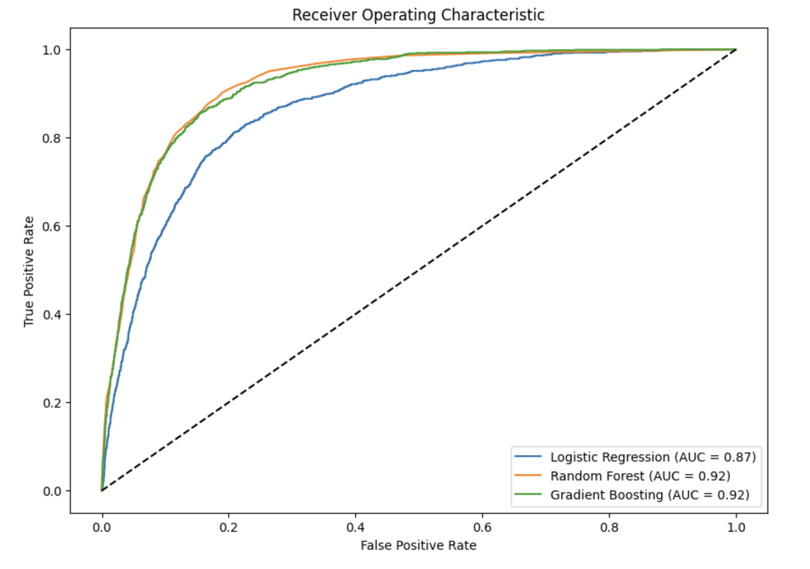
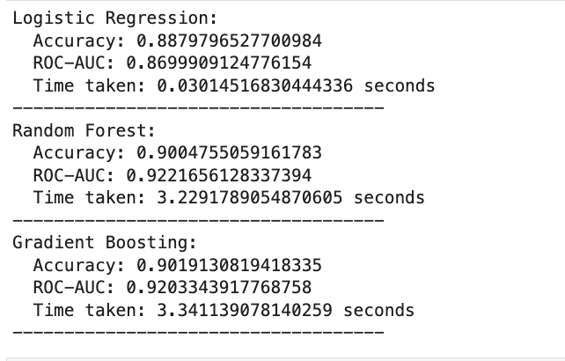
Model Implemented
Logistic Regression
Random Forest
Gradient Boosting

Slide 10
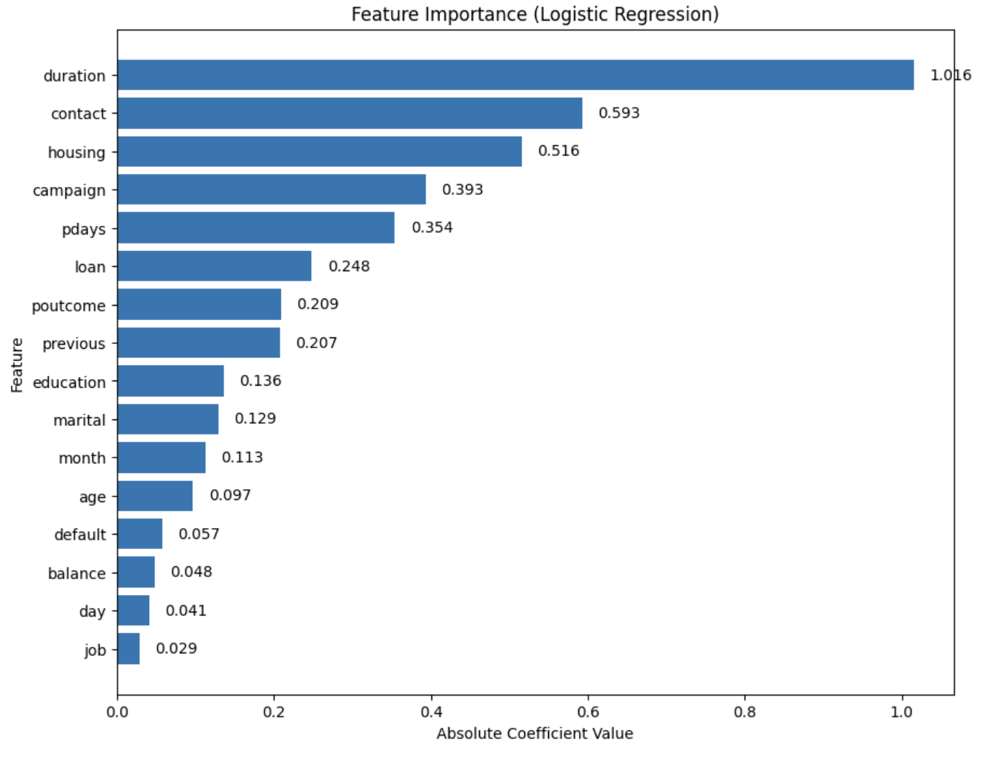
Qualitative Result Interpretation

Slide 11
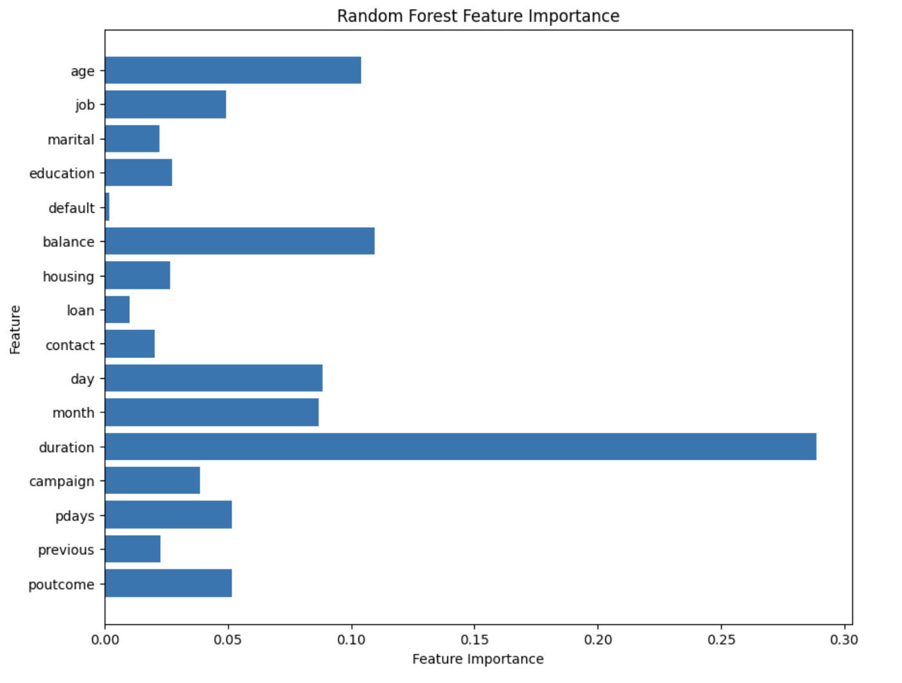
Qualitative Result Interpretation

Slide 12
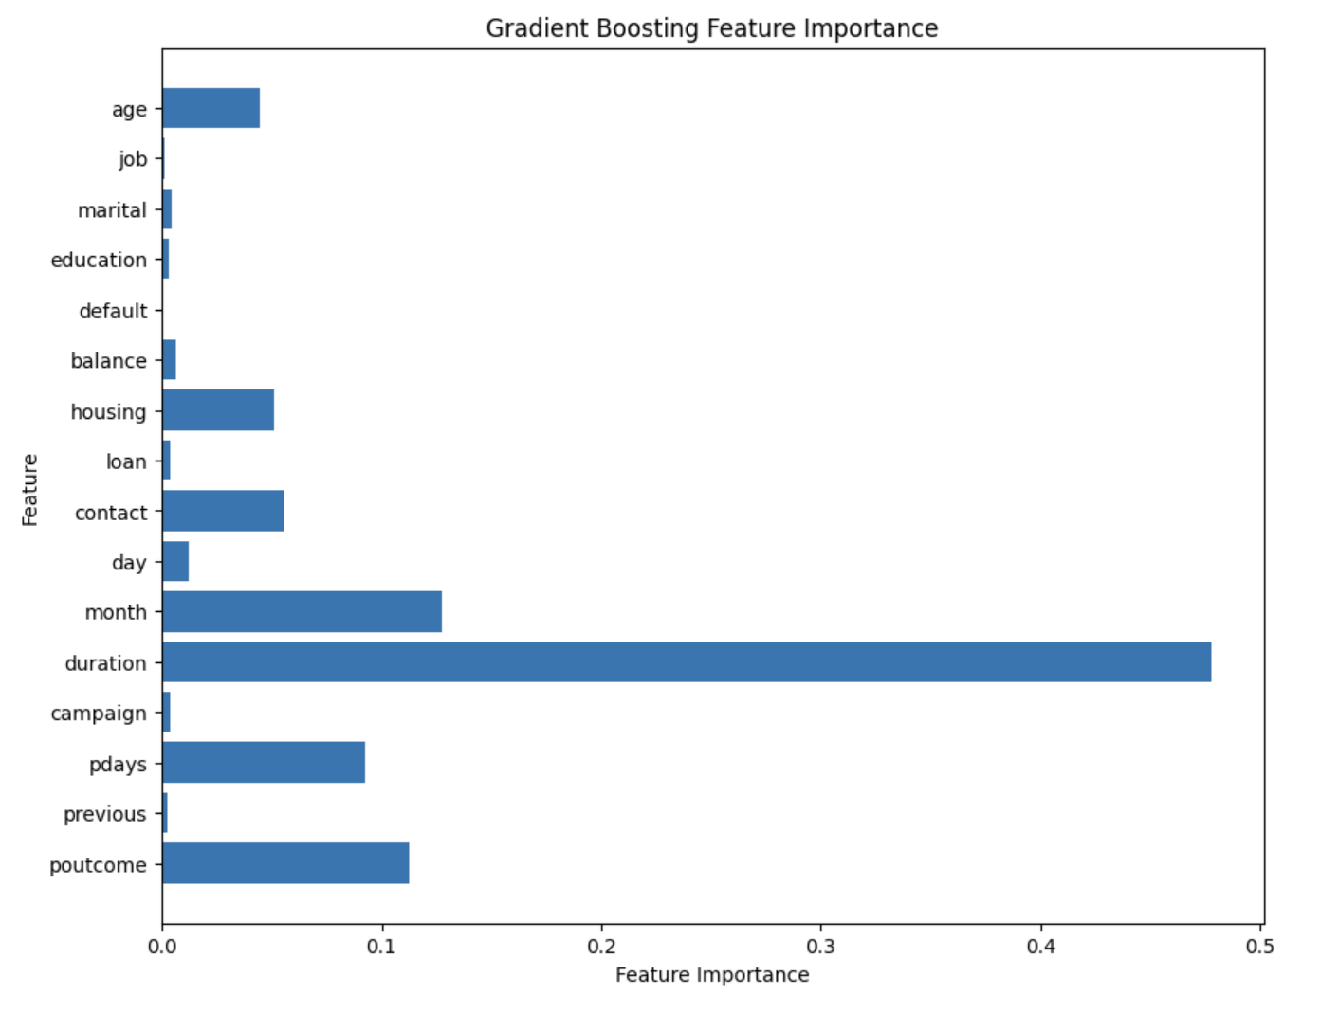
Qualitative Result Interpretation

Slide 13
Conclusion
Key Insights:
Identified key influencing features: Age, loan duration, housing, etc.
Interpreted results both quantitatively and qualitatively.
Impact & Application:
Assists the banking sector in enhancing marketing strategies.
Directly influences decisions related to customer targeting for term deposits.

